Slide 1

Positive Energy Summit
Big Easy, TX
Apr 2026
Scott W. Tinker

Slide 2

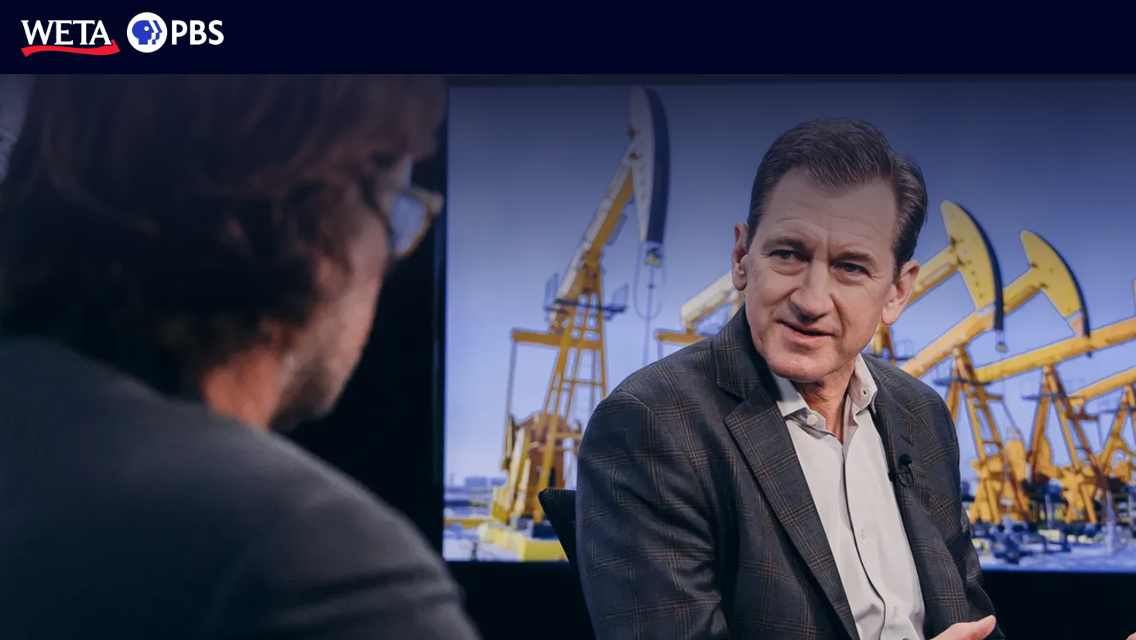
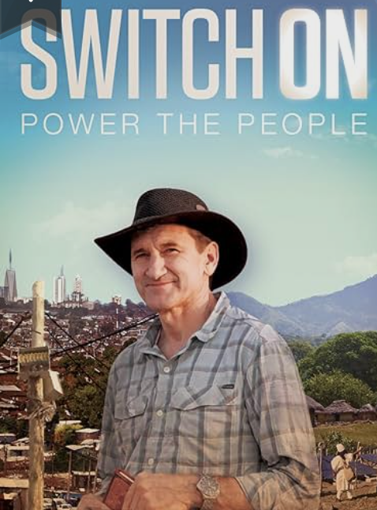




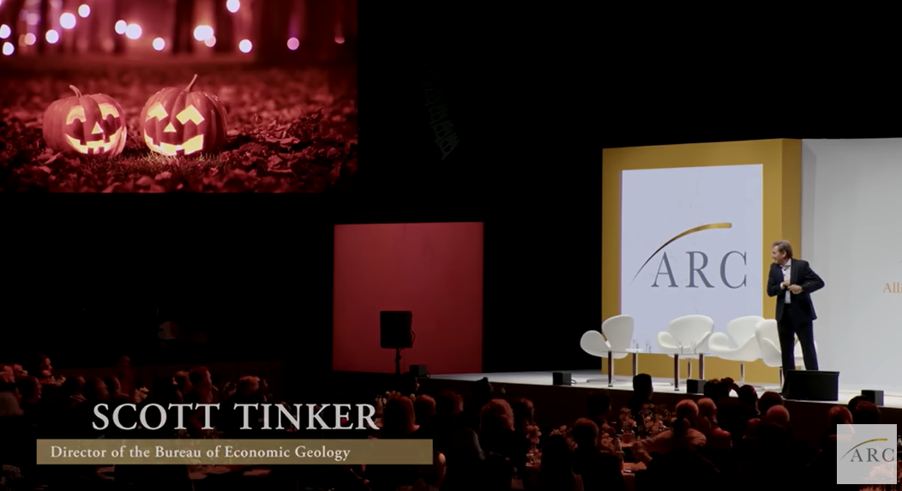
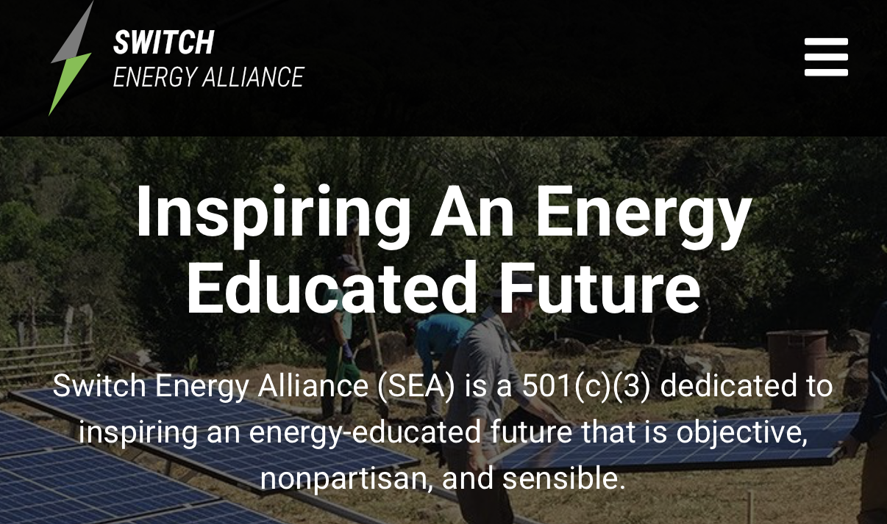

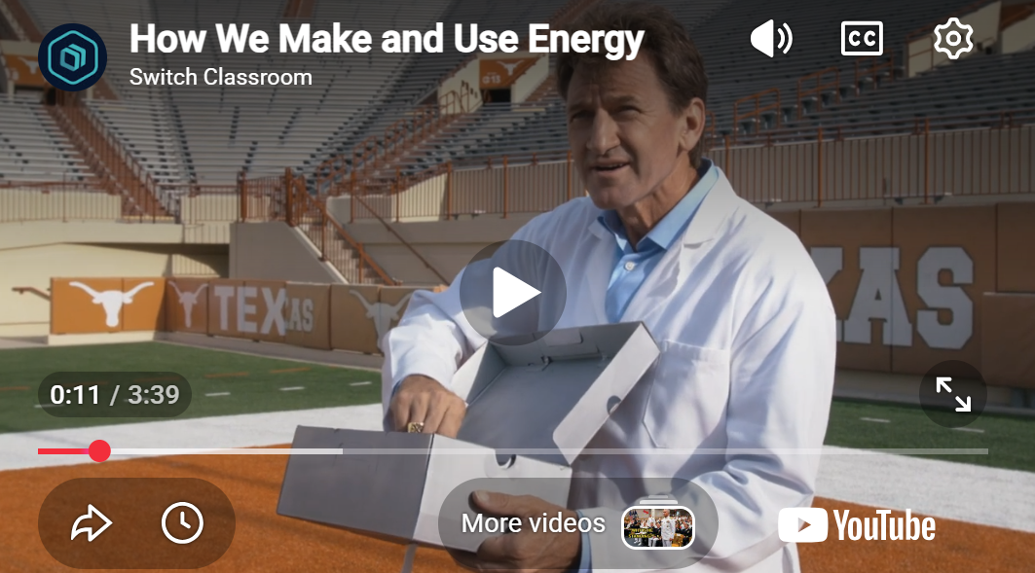
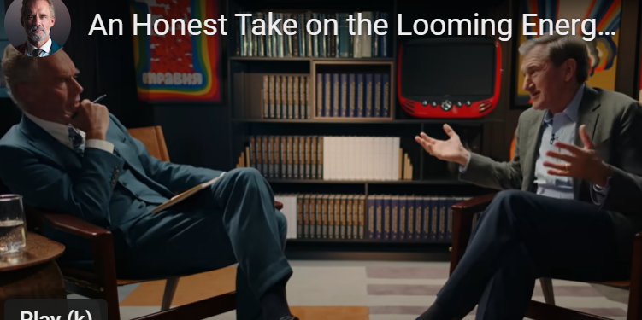

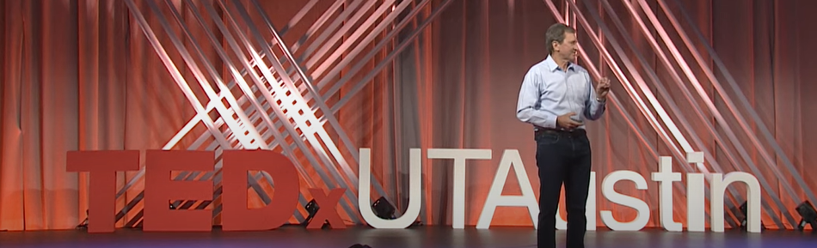


‘08
‘10
‘15
‘20
‘25
ENERGY SWITCH
A brief history of Switch
When Harry met Scott…
2008 Obama First Term

Slide 3
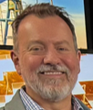
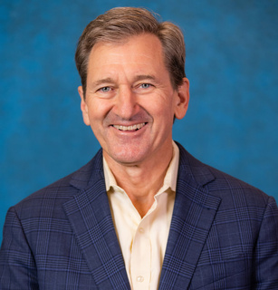
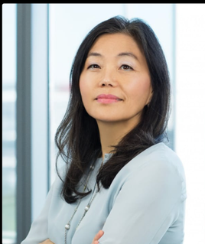
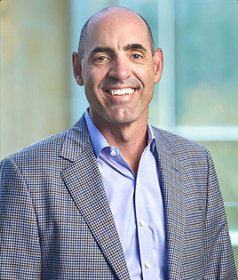
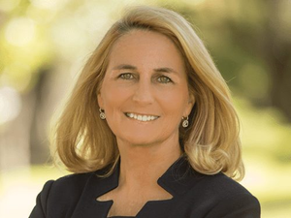
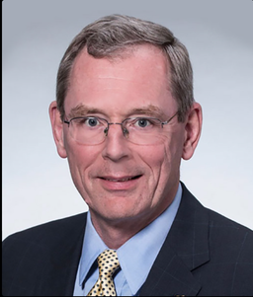
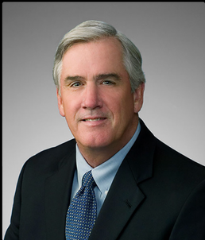
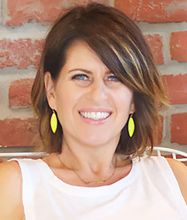
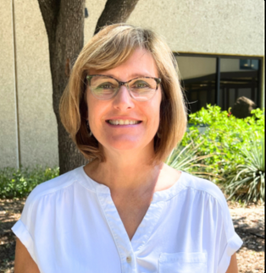
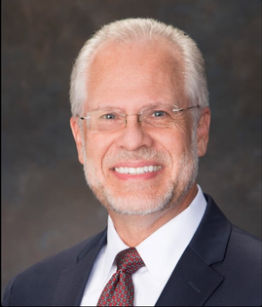
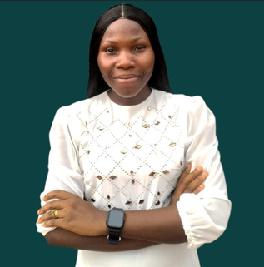
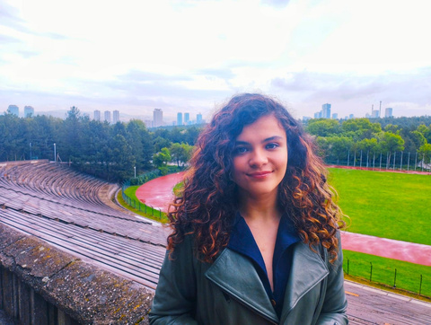
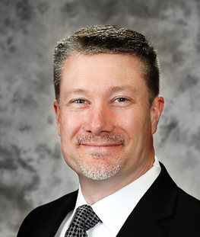
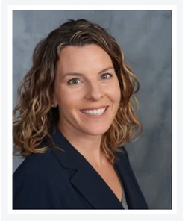
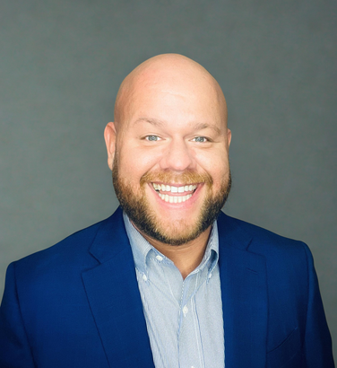
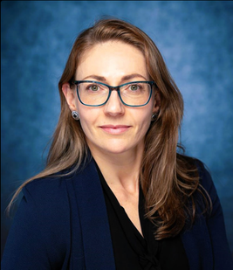
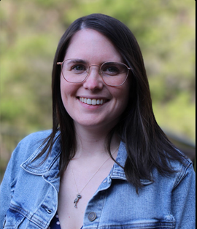
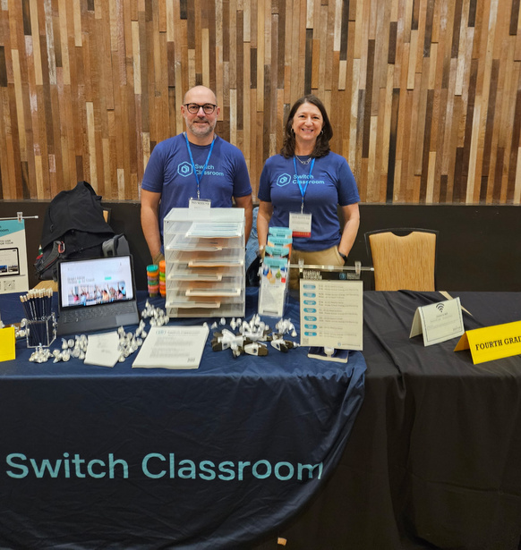
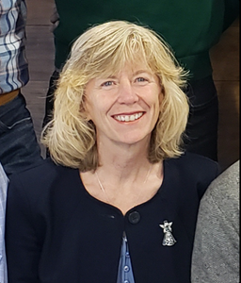
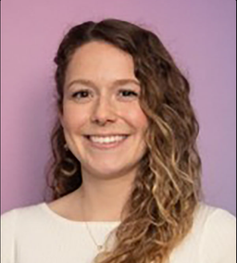
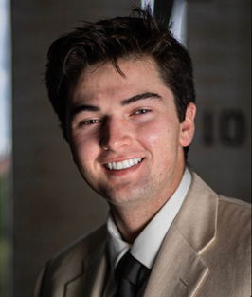
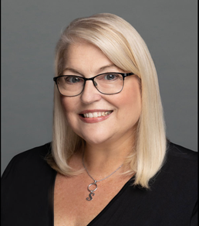
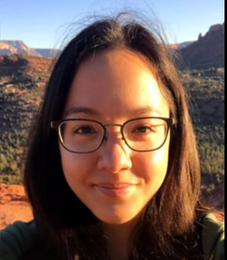
OUR TEAM
Our Board of Directors
ARCOS FILMS
Harry Lynch, Yusef Svacina, Ginny Patrick
Switch, Switch On, Energy Switch, EarthDate
Our Contractors & Part-Time Team
Chairman
Director
Director
Director
Director
Director
Scott W.
Tinker
Deborah
Byers
Mike
Howard
Melody
Meyer
David
Rainey
Dick
Stoneburner
Our Full-Time Team
Energy Switch
Associate Producer
EarthDate
Content Writer
Program Associate
Switch Competition
Switch Ambassador
Network - Lead
Switch Ambassador Network - Comms
Emily Hooks
Lynn Kistler
Carl Steffensen
Chinazaekpere Arukwe
Medina Ziyadkhanova
President
Manager of
Education
Program Manager,
Higher Ed
Program Manager,
Professional Ed
Marketing & Comms. Manager
Our Advisory Committees
Gary Hines
Meghan Morgan
Zach Carr
Lindsey Anderson
Sarah Clary
Switch Energy Alliance works with advisory committees in higher education and K–12 classrooms.
Faculty, educators, and curriculum specialists provide ongoing input to maintain academic rigor, classroom usability, and a consistent standard of objectivity.
Manager of
Operations
Program
Associate
Media Content Coordinator
Exec. Support & Donor Engagement
Content
Coordinator
Sarah Todd
Jillian Swets
Grey Johnson
Stephanie Huntzis
Angela Marraudino

Slide 4
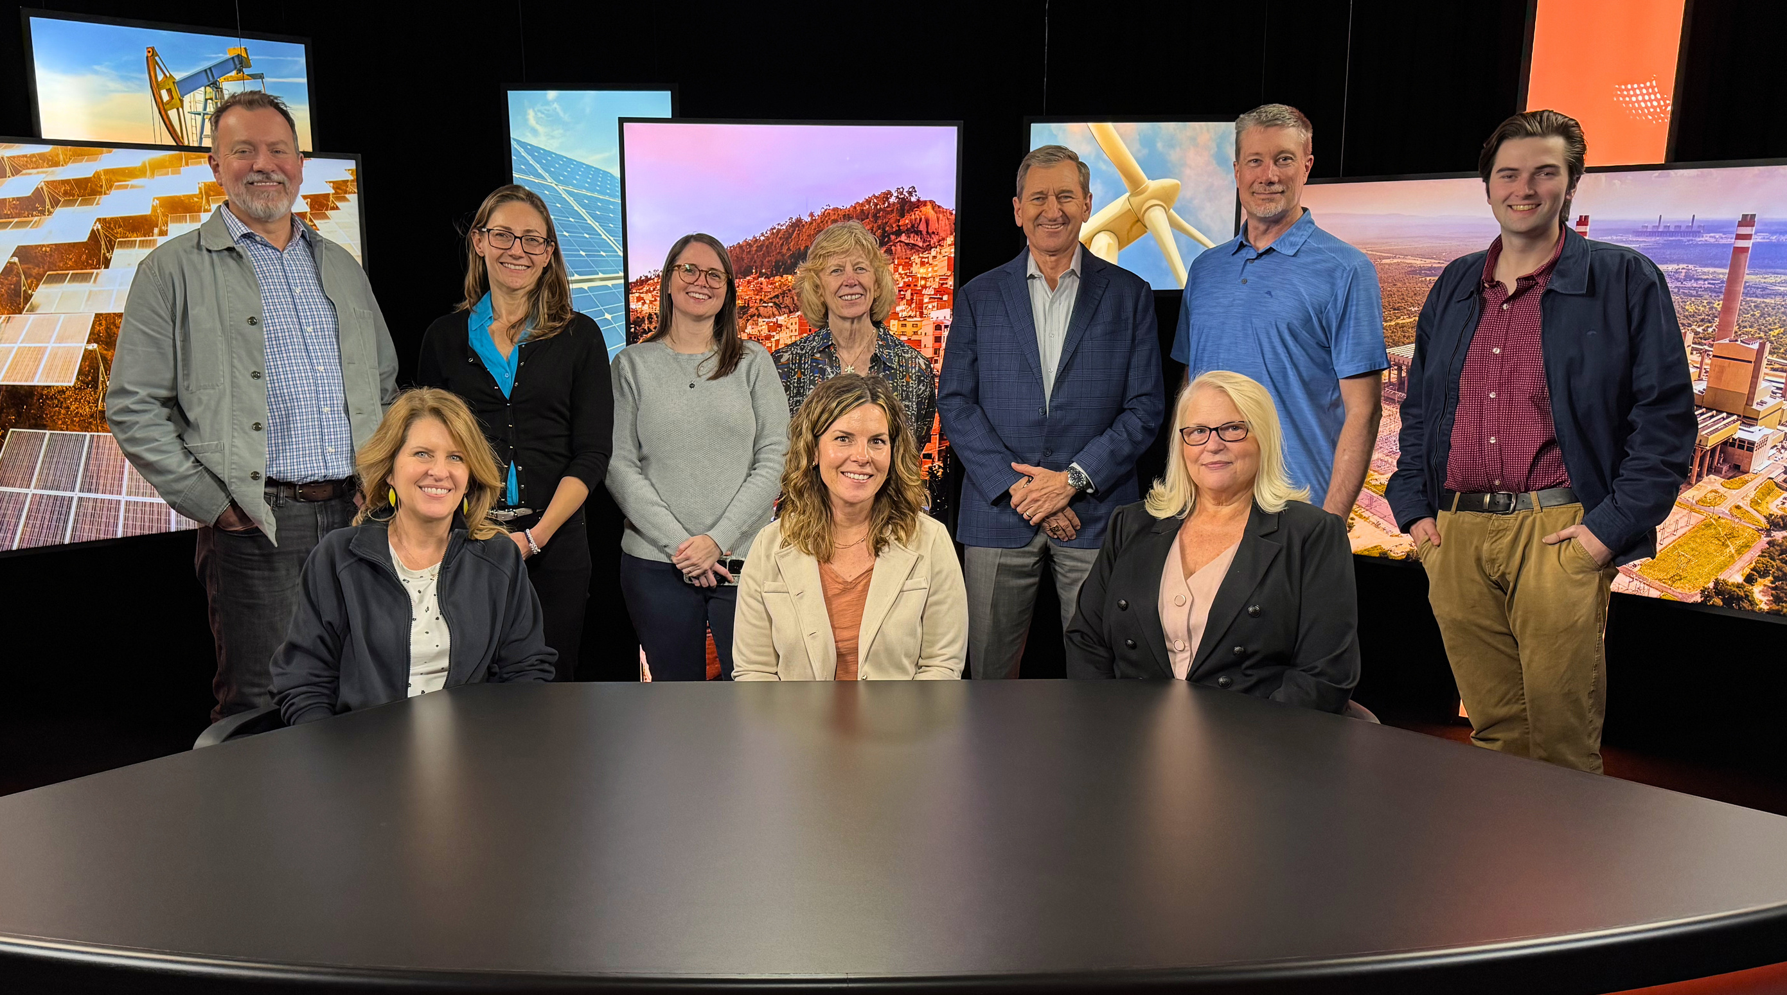
WE ARE REACHING THE WORLD… and we’re JUST GETTING STARTED
290M
29K
educators engaged
touched globally
2.9M
students reached
> 60
countries involved

Slide 5
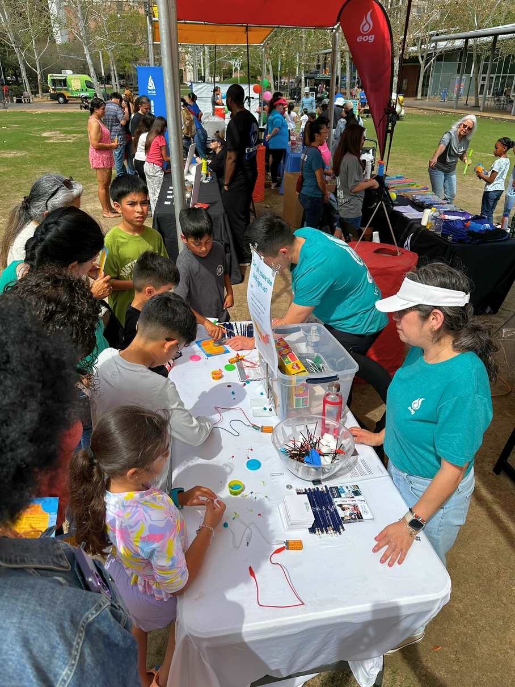
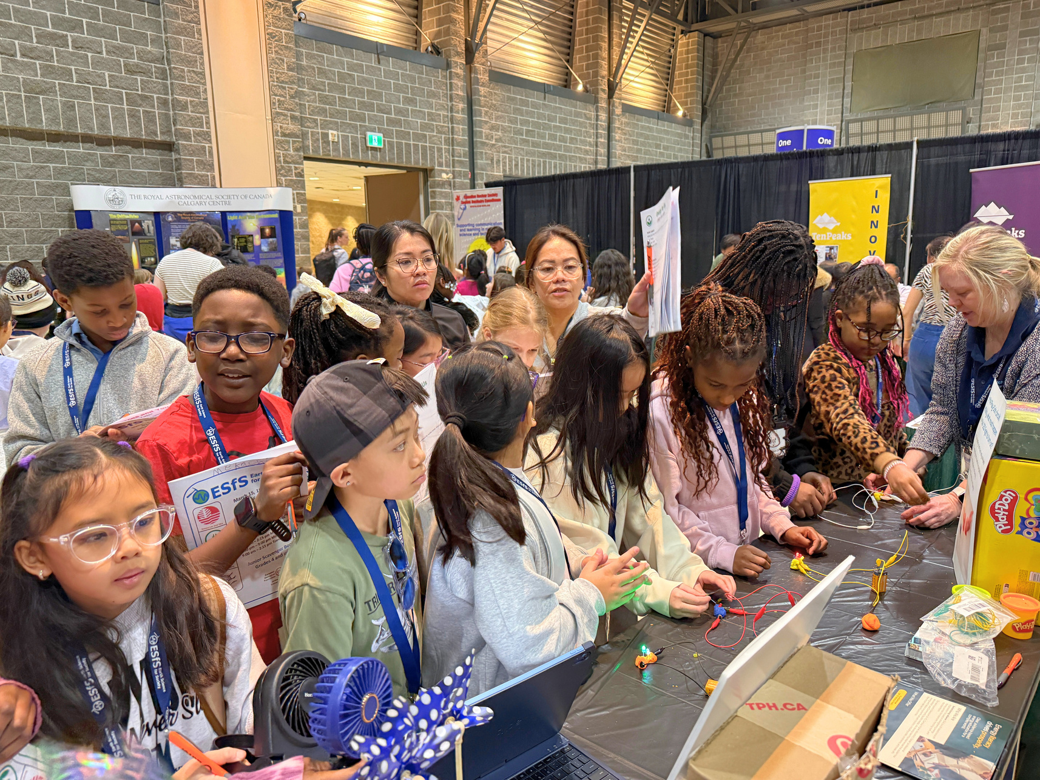

Your learning partner for life…
PILLARS
Classroom → Campus → Career → Community
SEA connects with a worldwide audience at every stage of life to enable life-long learning
Reach
Learn
Why We Do It
Lead
Engage

Slide 6
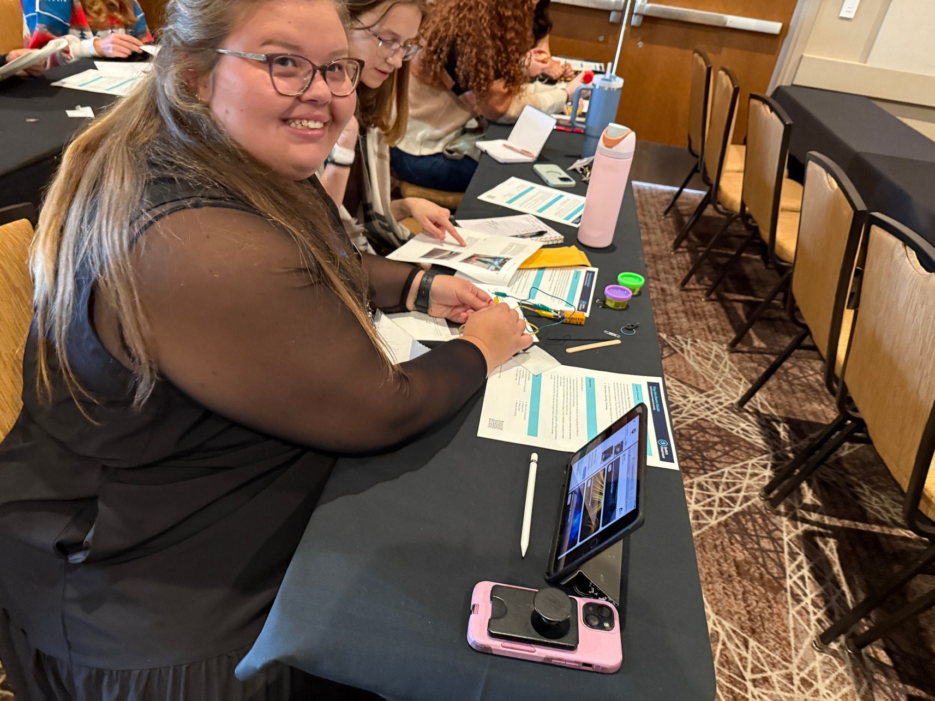
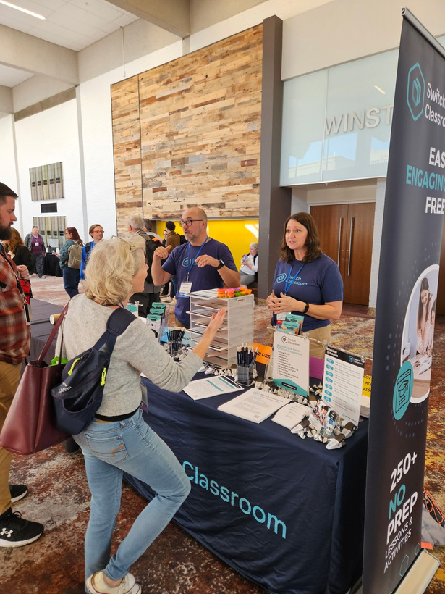
SWITCH CLASSROOM
K-12 EDUCATION
Building energy literacy from the beginning
This is where understanding begins

Slide 7
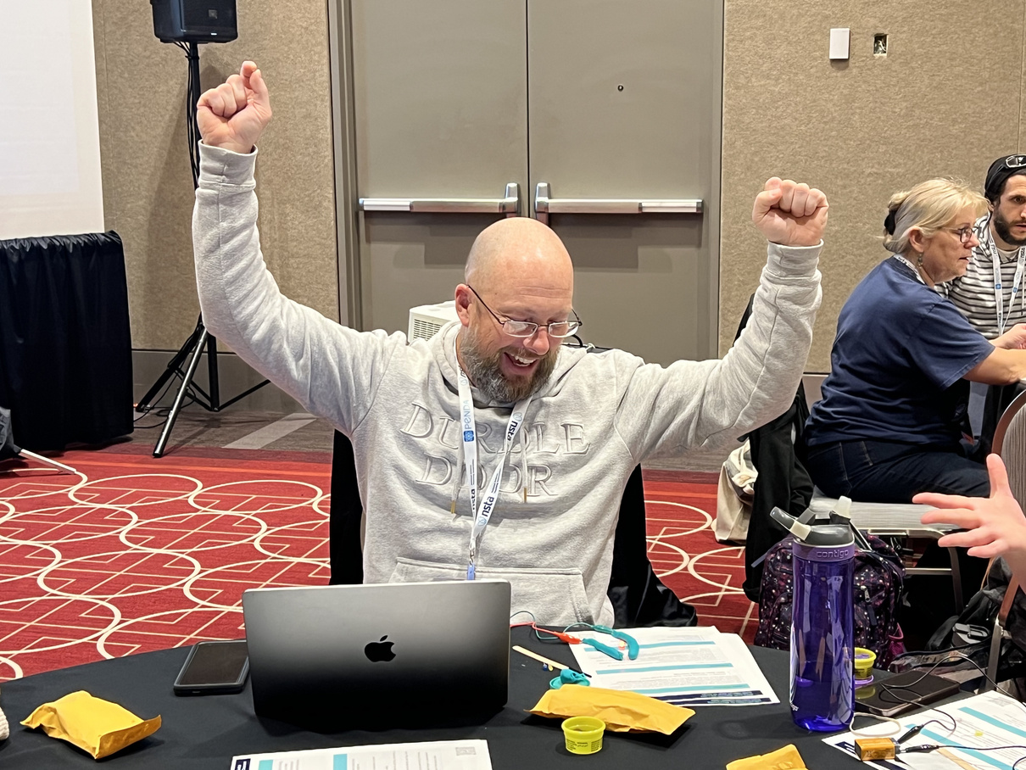
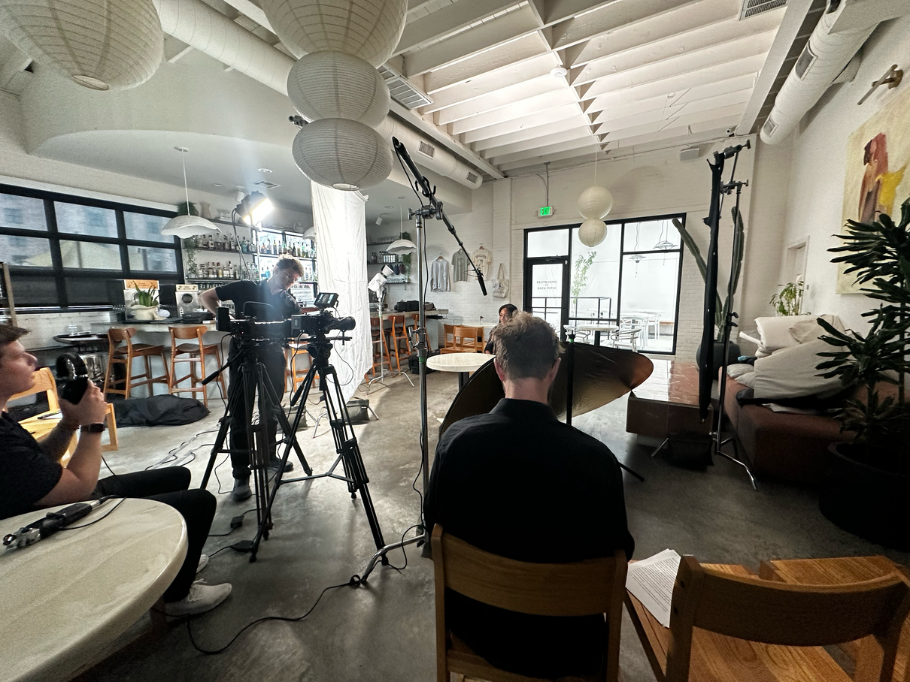
SWITCH CLASSROOM 2025
Our Method
Publish
Teach
Support
267
24
54
Lesson Activities
Webinars and Workshops
Resources Developed
Online, Supplemental, Free
How Our Resources Reach Classrooms
Content
Confidence
Adoption
Adopted by educators. Reaching millions of students.
29 K
1 : 100
Educators Resourced
Teacher/Student

Slide 8
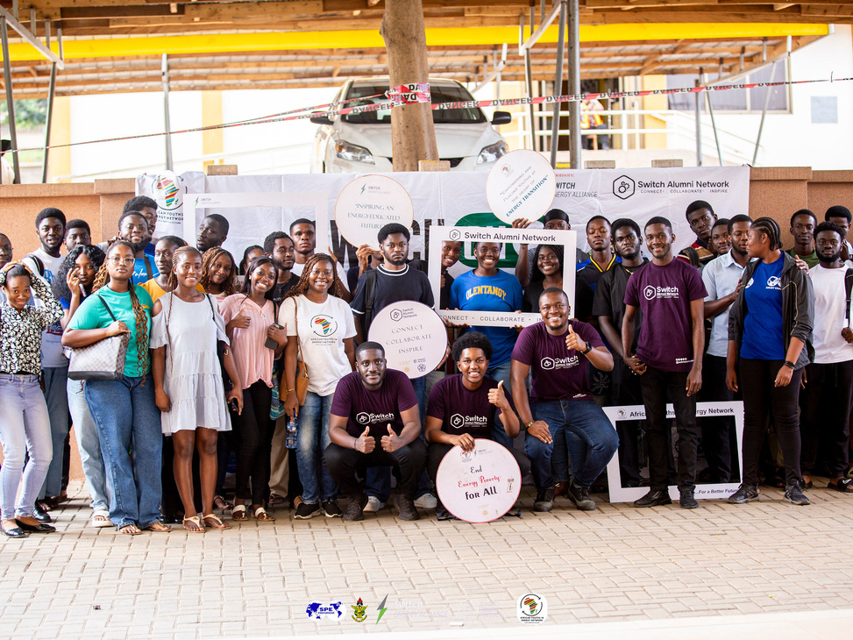
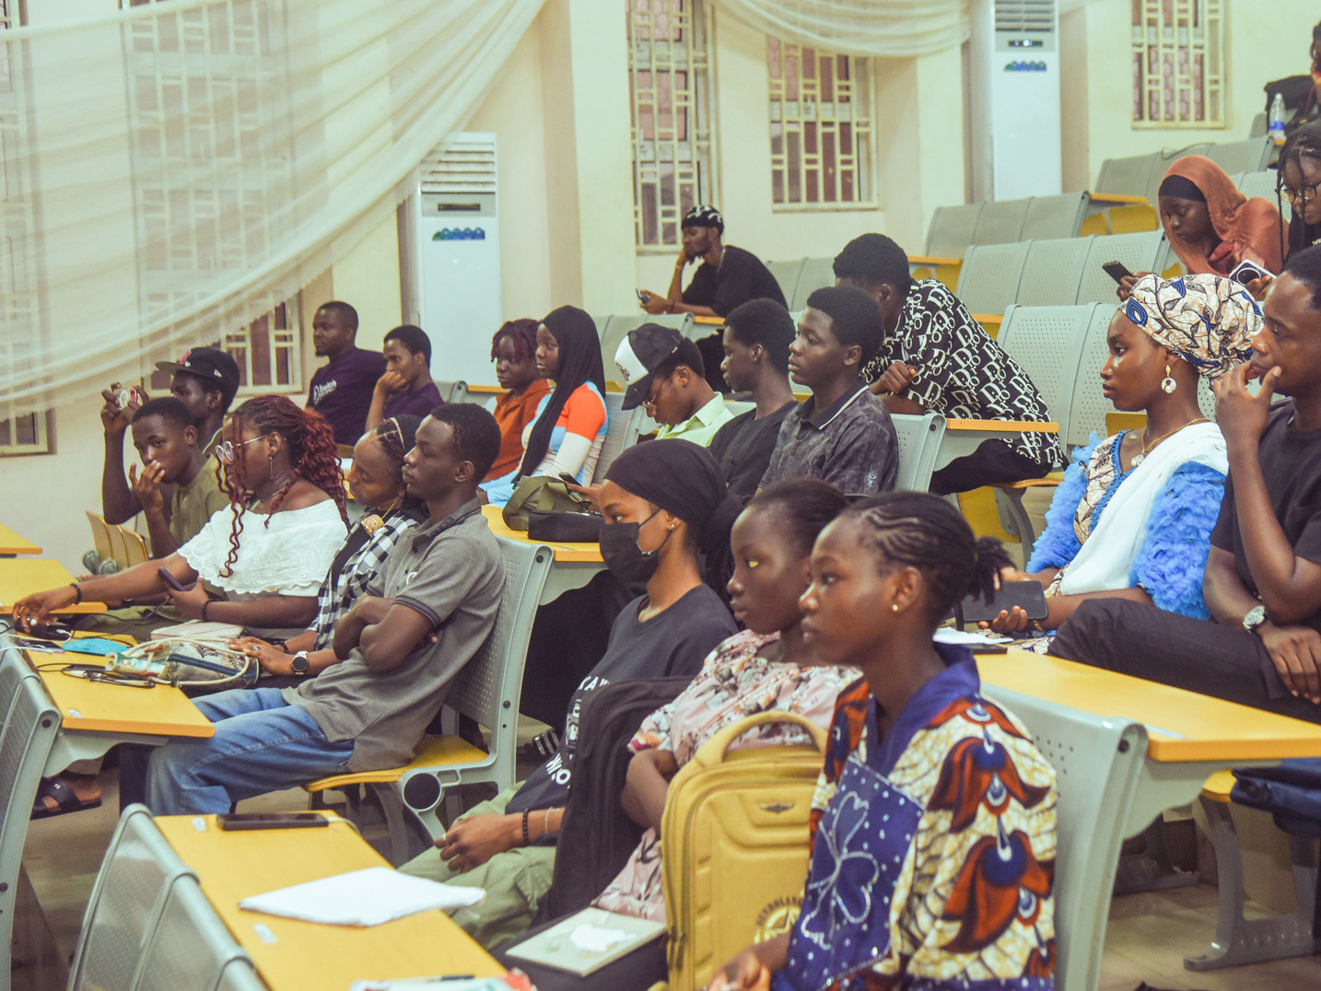
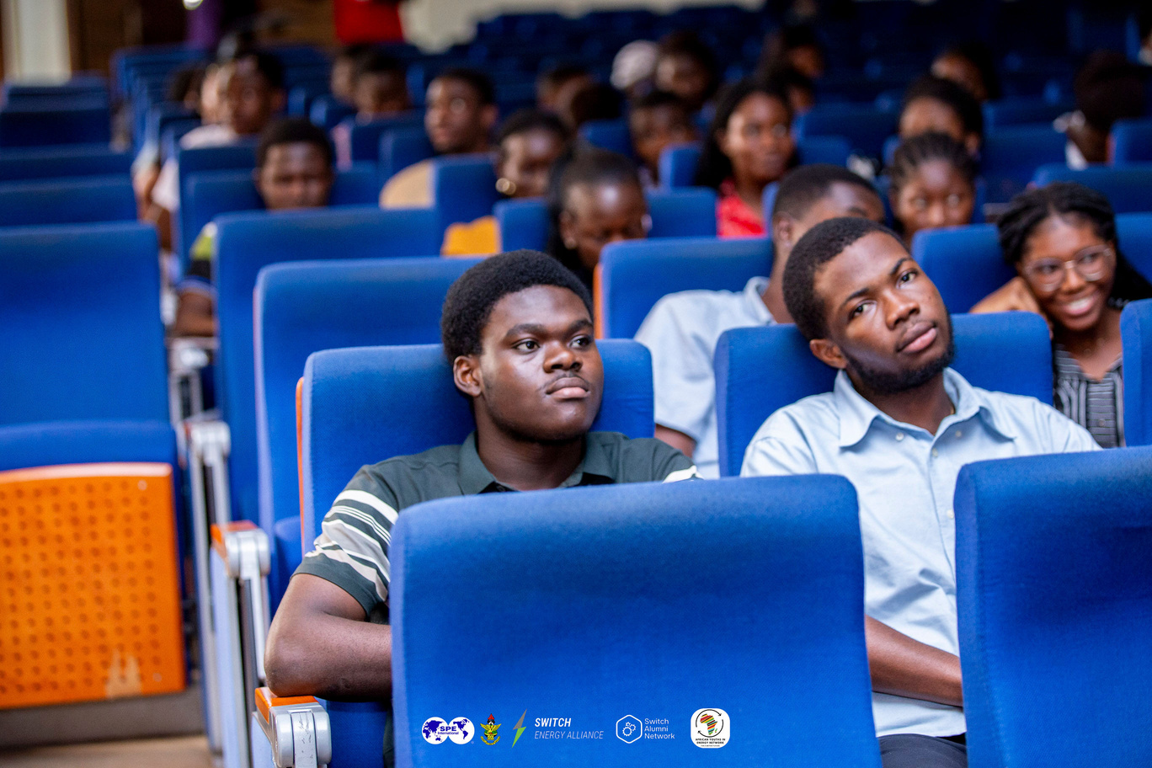
SWITCH CAMPUS
HIGHER EDUCATION
From Textbooks to Real-World
Switch Campus brings global students together to tackle real energy challenges.
A competition grows into a global network of students, educators, and industry professionals.
Where future leaders emerge.
This is where knowledge is applied

Slide 9
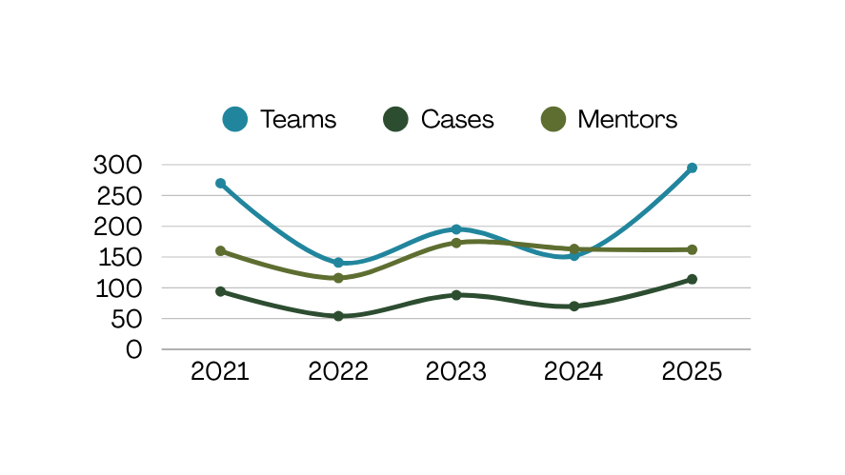
SWITCH CAMPUS 2025
Engaging students. Applying knowledge globally.
Industry experts actively engaged
172 volunteers supporting students globally
Students
989
Switch Ambassador Network
Teams
295
Hundreds of Students
Universities
75
Dozens of Countries
Volunteers
172
Involved and Educated
Countries
27
Lifelong Engagement
Film Screenings
15
Fellowships for Energy CORPS

Slide 10
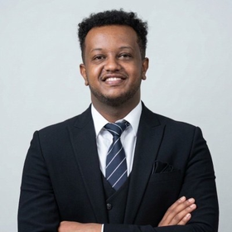
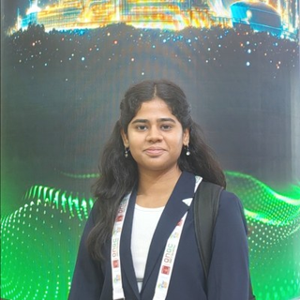
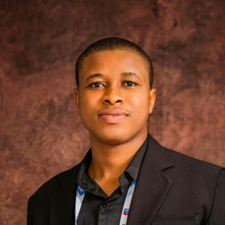
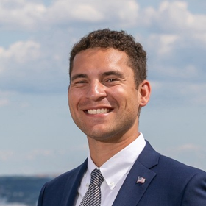
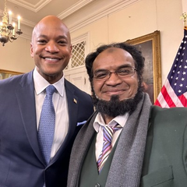
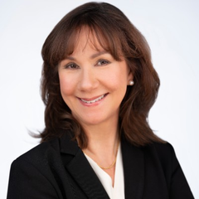
SWITCH COMPETITION 2025
Lasting Impact
Abiy Kifle Assefa
Priyanshi Saxena
Shammah Ndubuisi
Terren Wise
2025 Switch Competition Second Place Winner
2025 Switch Competition Participant
2025 Switch Competition Participant
2025 Switch Competition Participant
“Energy poverty isn’t just a development issue; it’s a human one — shaping how people learn, work, and live.
And solving it requires awareness, collaboration, and intentional action.”
“It pushed me to think beyond numbers and towards systems. Beyond theory and toward implementation. Beyond engineering and toward human impact.”
“This may not have ended with a trophy, but it has definitely deepened our commitment to working on data-driven, equitable energy solutions – and we are excited to take these learnings into future projects and competitions.”
“Energy poverty isn’t just a development issue; it’s a human one — shaping how people learn, work, and live.
And solving it requires awareness, collaboration, and intentional action.”
“This experience sharpened my skills in energy policy analysis, cross-border strategy, and working under pressure, traits that I'm excited to bring to future projects in the energy sector.”
“I had the privilege of mentoring four outstanding students... as they crafted a comprehensive 10-year design plan for Hungary focusing on four critical pillars: Energy Supply, Energy Demand, Energy Poverty, and Energy Security.
Although we didn't take home the win, the collaboration and dedication of our team made this experience invaluable.
I applaud their hard work and commitment to making a difference in the world!”
“I am profoundly honored to receive a certificate of appreciation acknowledging my contributions as a judge and mentor to three outstanding teams from Peru, Nigeria, and India. ... The exceptional potential demonstrated by these dynamic teams inspires immense pride in me.”
“I had the privilege of mentoring four outstanding students... as they crafted a comprehensive 10-year design plan for Hungary focusing on four critical pillars: Energy Supply, Energy Demand, Energy Poverty, and Energy Security. Although we didn't take home the win, the collaboration and dedication of our team made this experience invaluable. I applaud their hard work and commitment to making a difference in the world!”
Dr. Tariq Masood
Jeanette Pablo
Mentor & Judge for the 2025 Switch Competition
Mentor for the 2025 Switch Competition

Slide 11
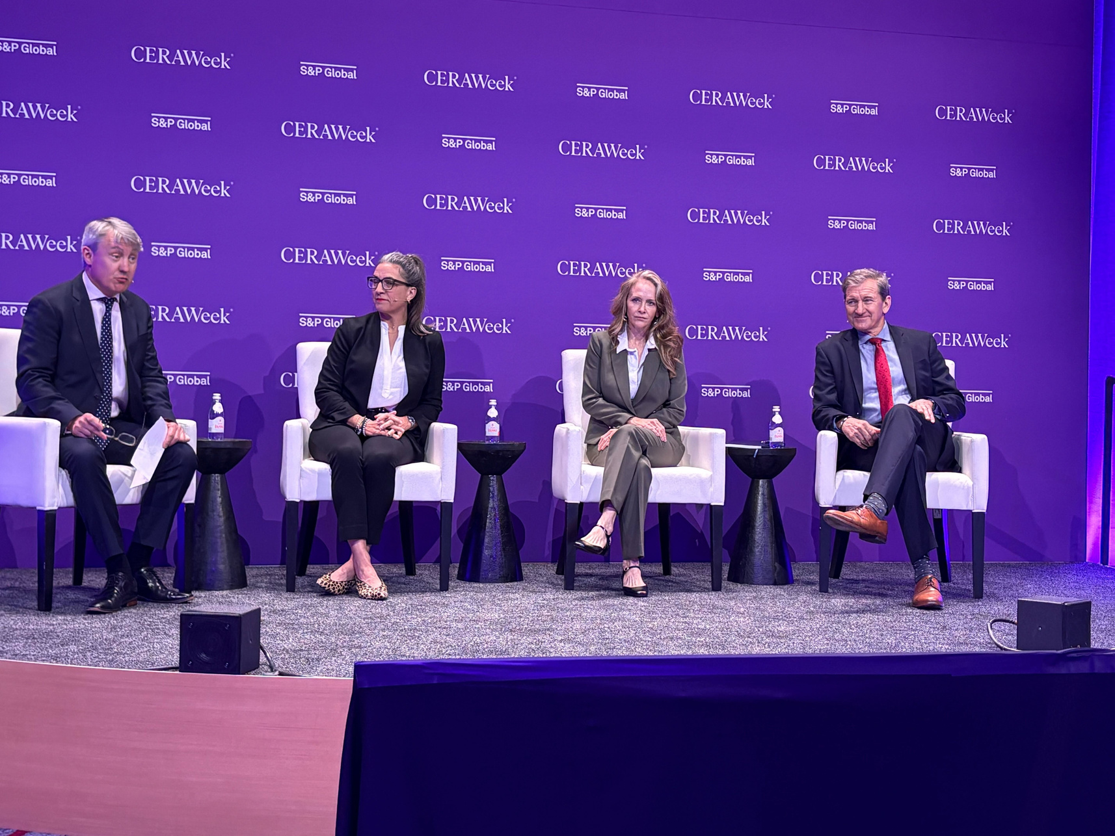
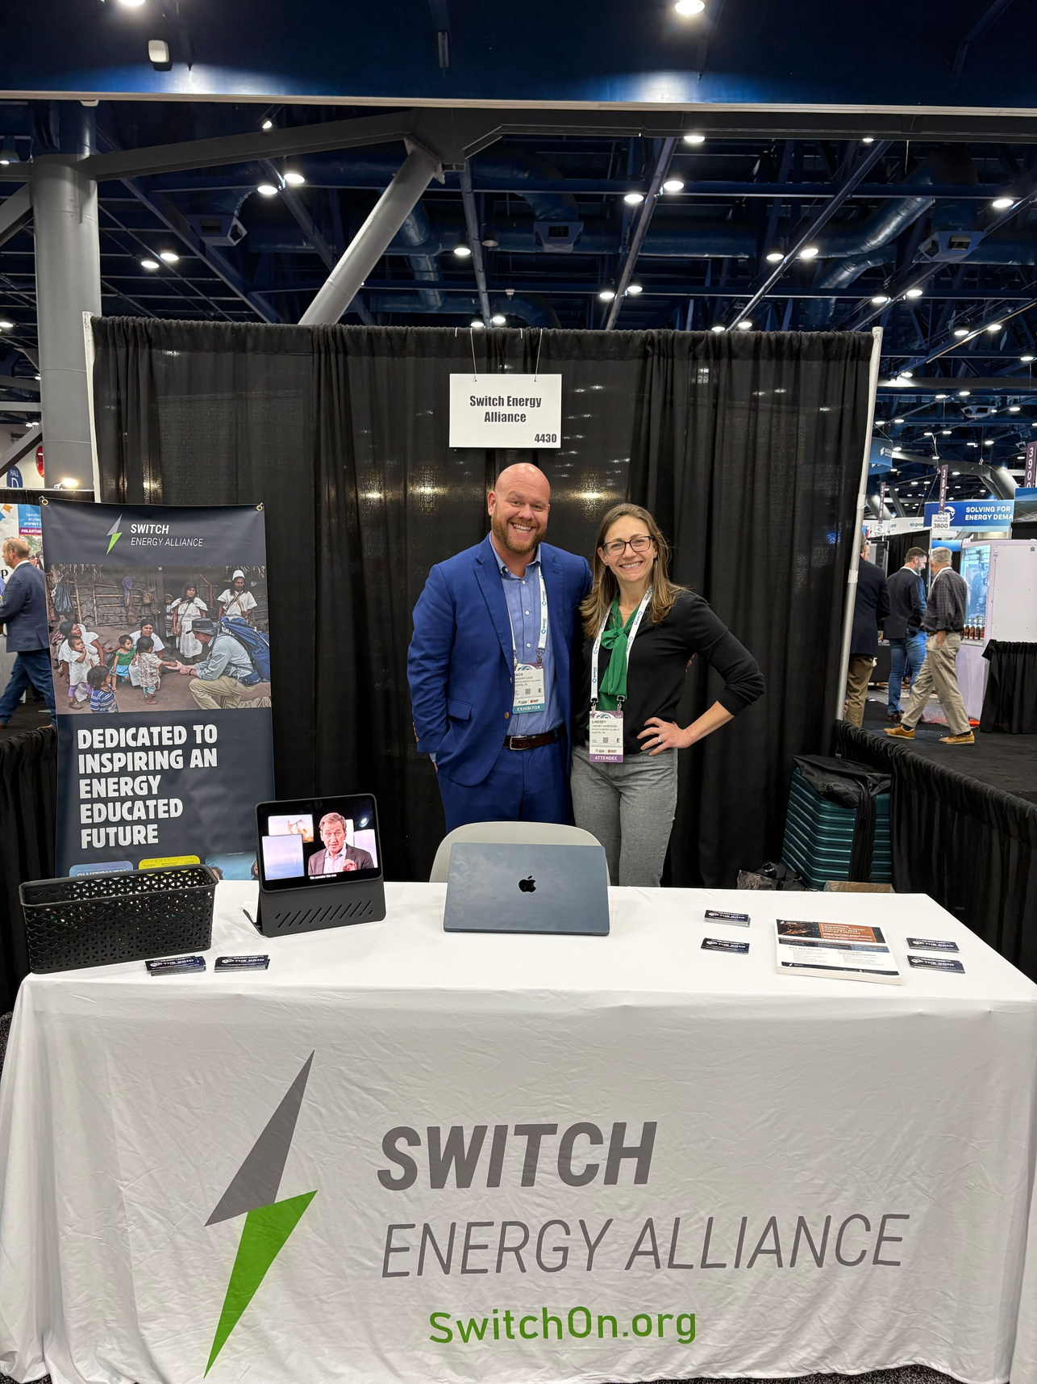
SWITCH CAREER
PROFESSIONAL EDUCATION
This is where Professionals grow
Switch Academy
Engaging, subscription-based courses at all learning levels
Requires knowing what people need to understand
Grounded in how energy systems function

Slide 12
SWITCH CAREER 2025
SWITCH ACADEMY
Defined. Resourced. Advancing to launch.
The Scale of the
Energy Workforce
Full-time program leadership in place
$2.8T
Core curriculum defined
Annual global energy investment
Learning platform ready
Industry-informed design
8M
jobs supported by the U.S. energy workforce.
Building the capability to navigate the future of energy

Slide 13



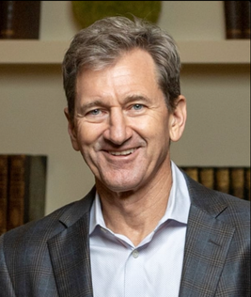



SWITCH COMMUNITY
PUBLIC EDUCATION
Reaching the world with trusted energy education
Our Content Is Thoughtfully Crafted by Teams of Experts
Host
Scott W. Tinker
Energy Switch Associate Producer
Emily Hooks
EarthDate Content Developer
Lynn Kistler
ARCOS Film + Music
Harry Lynch
We don’t simplify the dialog.
We make it understandable.
We meet people where they are, on television, radio, podcasts, lectures, global events, and digital platforms.
Energy Switch, EarthDate, documentary films, radio, lectures: clear, fact-based education at global scale.
This is where awareness begins

Slide 14










SWITCH COMMUNITY 2025
In 2025, Energy Switch Reached 87% PBS Market Penetration in the United States
Legend
Regions Airing Energy Switch on PBS
Regions without Energy Switch on PBS
PBS Market Coverage Growth
87%
110 M
98 K
11 M
households reached on PBS.
podcast listeners
radio listeners across 513 stations.
EarthDate

Slide 15
LOOKING AHEAD
2026 - 2028 ROADMAP
Scaling what’s proven
Content We present energy as it is—complex and diverse. Not simple, but solvable.
Quality Every program meets a high standard of clarity, credibility, and relevance.
Discipline We direct resources toward platforms and partnerships that extend reach while maintaining efficiency.
Scaling and Impact
Expand Global Impact
Grow Switch Classroom Adoption
Enhance Campus Engagement
Launch Switch Academy
Strengthen Partnerships

Slide 16
YOUR PARTNERSHIP MATTERS
Spread awareness about Switch Classroom
Mentor and Judge the Case Competition
Certify your staff with Switch Academy
Get educated with PBS Energy Switch & EarthDate
Share our Content with your networks
Make a multi-year Pledge of Support

Slide 17

YOUR SUPPORT
$500k
$2.0M
$3M
$3.5M

Slide 18






Switch is a known and proven brand.
We are going to the next level.
It can’t happen without you.
Website: switchon.org
Contact: info@switchon.org

